Slide 1
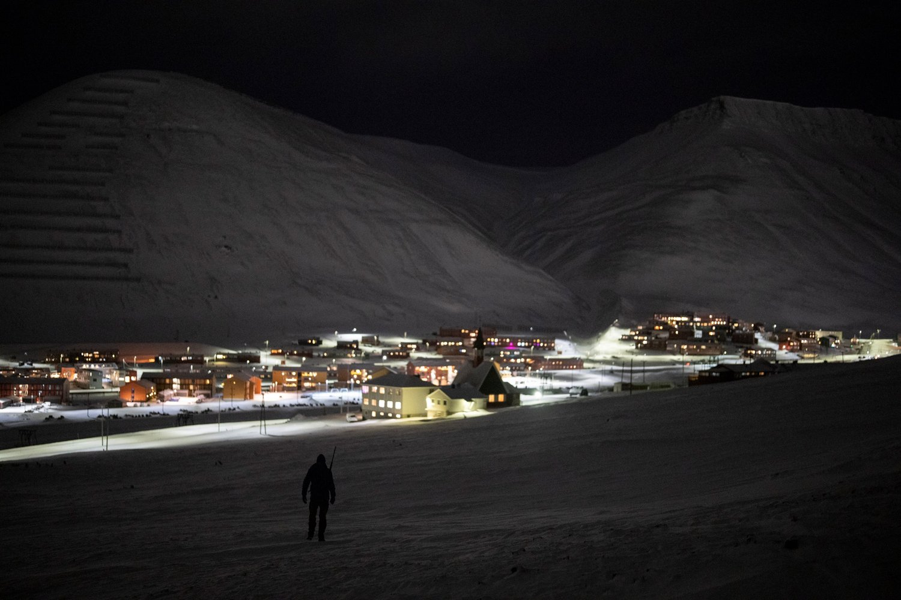

1 of 29
Your own Polar Bear Custodian
In Svalbard
by Mark Morris
www.co-ownershiptrust.com

Slide 2
2
Common CRS misinterpretations
Polar bear structure
Trust can be a Custodial Institution for AEoI
Resettle/decant polar bear custodian to new trust/foundation
Structure to resolve Liechtenstein’s Russian zombie trust crisis
Territories and dependencies excluded from Norway’s tax agreements
Alternate non-participating jurisdictions
Liechtenstein rejects Mandatory Disclosure Rules
Presentation
agenda

Slide 3
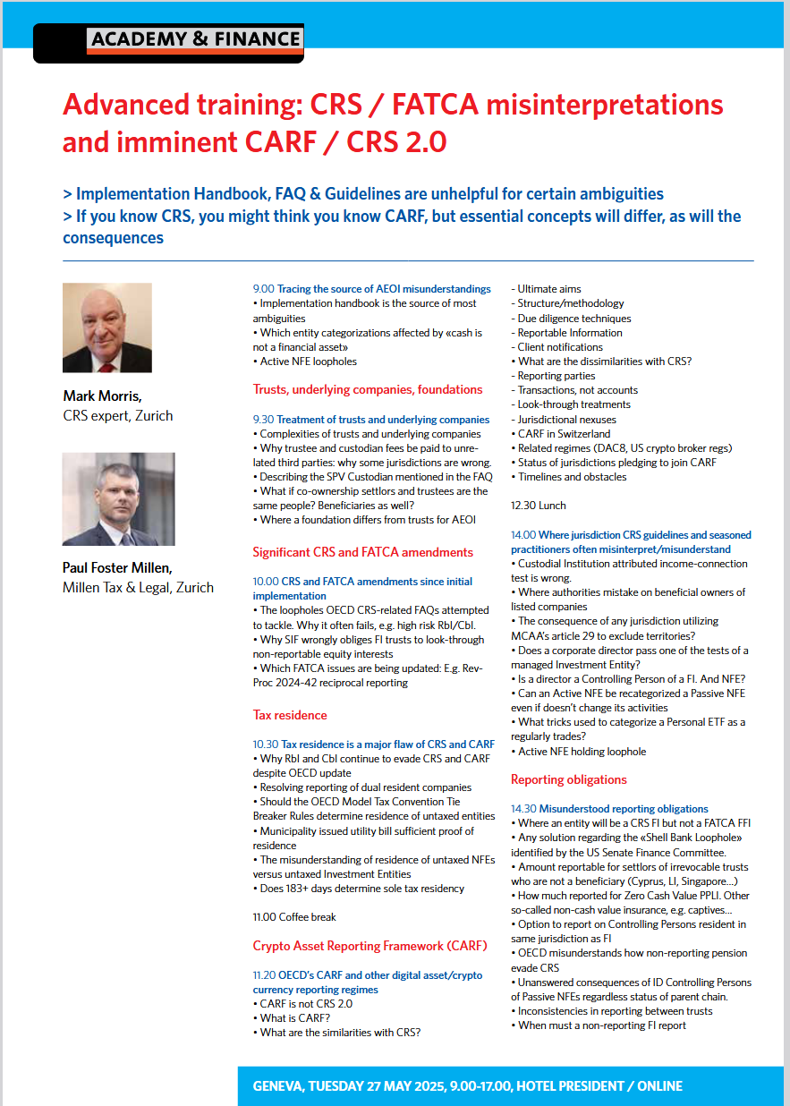
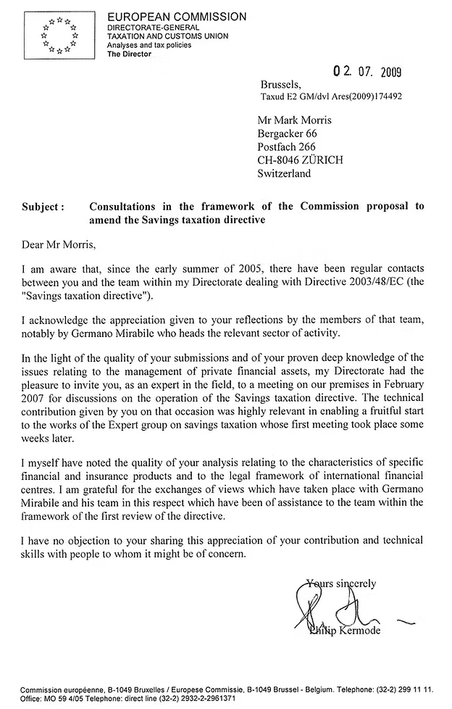
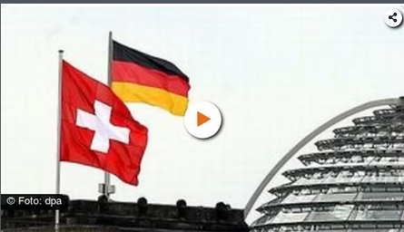
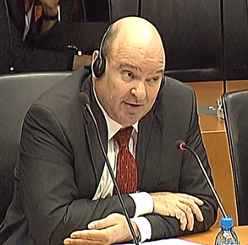
a). Common AEoI misinterpretations
3

Slide 4

Reportable Accounts
a). Common AEoI misinterpretations
4
Identify Reportable Accounts
Test 1 Reportable Accounts by virtue of the Account Holder (entity or individual) |  | Test 2 Reportable accounts by virtue of the Account Holders’ Controlling Persons
Is the Account Holder a Reportable Jurisdiction Person? | Is the Account Holder a Reportable Person | Is the Account Holder a Passive Non-Financial Entity? | Does the P-NFE have Controlling Persons which are Reportable Persons?
(irrespective of test 1)
Yes
Yes
Include Active NFE !
Yes
Look-through to Controlling Persons of Passive NFE regardless of status of entities in ownership chain - using FATF AML b.o. ⇨ incl. Active NFE, Non-reportable persons → Investment Entities, Custodial institutions, Insurers, traded, etc.
Yes
All, if wider-approach
Exclude if in same jurisdiction as FI
Where is untaxed entity resident, eg BVI (economic substance)?
Exclude Non-Reportable Person:
i. Regularly traded, ii. Govt entity, iii. International organisation, iv. Central bank, v. Financial Institution except non-participating jurisdiction I-E
Look through to controlling persons, excl. same jursidiction as FI
Reportable Account
Reportable Account

Slide 5
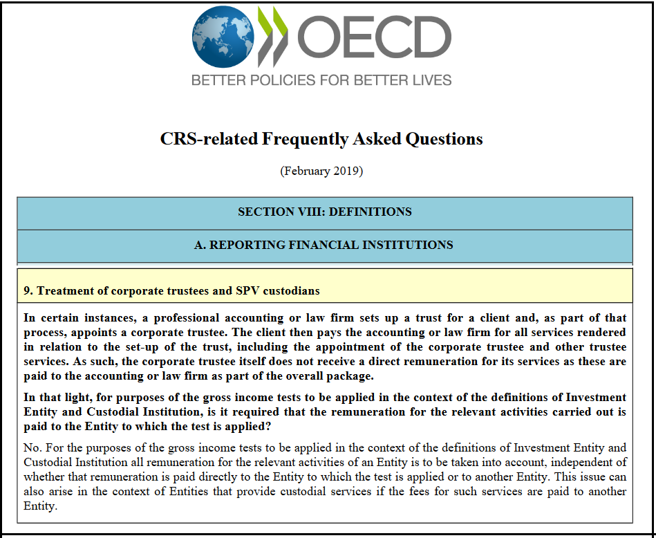
a). Common CRS misinterpretations
5
SPV Custodian fees may be paid to unrelated 3rd parties
SPV Custodian
A Special Purpose Vehicle is usually a subsidiary company (but not required to be owned by the company) on whose behalf the entity is created.
It is a legal entity or legal arrangement created for a specific purpose, usually a single project , which isolates the risk of the underlying assets from the sponsor's balance sheet.
* Custodial fees can be paid to unrelated third parties, eg. accountant, law firm helps set up the custodian
*

Slide 6
a). Common AEoI misinterpretations
6
CRS FI need not be regulated
The term “Financial Institution” means a Custodial Institution, a Depository Institution, an Investment Entity, or a Specified Insurance Company
Whether an Entity is subject to financial laws and regulations of a Participating Jurisdiction or is subject to supervision and examination by agencies having regulatory oversight of Financial Institutions, is relevant to, but not necessarily determinative of, whether that Entity qualifies as a Financial Institution
Only Canada requires CRS FIs to be regulated
  Netherlands and Luxembourg dropped this requirement upon pressure from OECD

Slide 7

a). Common AEoI misinterpretation
7
Election for Non-Corporate Entities as parent in EAG for FATCA
For US taxes 80% ownership or under common ownership, for FATCA reduced to 50% for FFIs
FFIs that are part of an EAG must ensure all members comply with FATCA, where a "Lead FI" manages the registration process for the entire group, streamlining compliance Anti-Inversion Rules moving US company's headquarters to a foreign country to reduce US taxes
One rotten apple spoils the barrel - if one member of an EAG is a non-participating FFI, then all members of EAG are non-participating FFIs (30% penalty withholding)
Registering the trust and underlying entity as an EAG depends on a formal election for non-corporate entities
Only a corporation can automatically be treated as the common parent of an EAG.
  Non-corporations (trust or partnerships) - would not automatically be an EAG as parent
  However, the regulations provide an election that changes this treatment
Election for non-corporate entities as parent in EAG:
    IRS regulations state that an entity other than a corporation may elect to be treated as the common parent entity for determining the composition of an EAG
    This indicates that your SPV Custodial Institution trust is not part of an EAG but is if optional formal election made.
    Authoritative source for this rule and election is 26 CFR § 1.1471-5(i)(10)

Slide 8

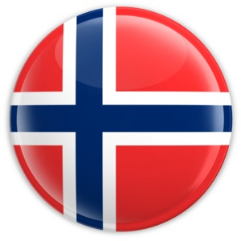






b). Polar bear structure
8
Individual Trustee
(Svalbard Resident)
3
UK non-resident Trust
(Custodial Institution)
Settlor
Beneficiaries
2
Director (Usually client/settlor)
FI discretionary asset manager
Managed
Investment Entity
1
? Potential Points of AEoI reporting

Slide 9
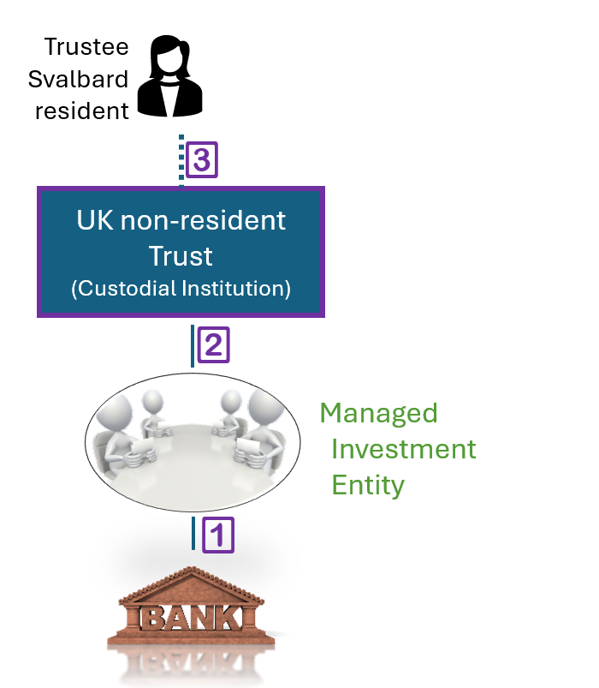
b). Polar bear structure
9
1 Nil reporting by FI (bank) maintaining financial assets of an FI Investment Entity
Reportable Person means a Reportable Jurisdiction Person other than an entity i). Regularly traded, ii). Govt entity, iii). International organisation, iv). Central bank, v). Financial Institution except non-participating jurisdiction investment entity:
Financial Institutions are:
Custodial Institution
Depository Institution
Specified Insurance Company
Professionally Managed Investment Entity
  Income test: > 50% passive income, and
  Asset management test : Mix of FI discretionary basis and individuals
  No asset test (only for Active NFE type A)
Managed
Investment Entity
1

Slide 10
10
b). Polar Bear structure
2 Nil report (or no reportable persons) by Investment Entity if its Equity Interest held through a Custodial Institution
The equity interest in the Investment Entity is exclusively the FI Custodial Institution trust (or trustee on behalf of trust)
CRS excludes Financial Institutions (incl custodial institutions) from the definition of Reportable Person
CRS Commentary page 178 par 69-71: Where Equity Interests of an Investment Entity are held through a Custodial Institution, the Custodial Institution is responsible for reporting, not the Investment Entity.
There is no “look-through” by the Investment Entity of a non-participating Custodial Institution FI
US Senate Finance Committee report on “Shell bank loophole”
UK non-resident Trust
(Custodial Institution)
2
Managed
Investment Entity

Slide 11
11
b). Polar bear structure
3 No AEoI reporting obligation by non-participating Custodial Institution
Trustee
Svalbard
resident
CRS
Non-participating jurisdiction Custodial Institution has no reporting obligations
3
Non-UK Trust
(Custodial Institution)
FATCA
Non-participating FFI has no reporting obligations if does not receive US source income
No 30% withholding penalty
No recalcitrant reporting
Not part of an EAG

Slide 12
12
b). Polar bear structure
UK non-resident trust
None of the trustees are resident in the UK for tax purposes, or
At least one of the trustees is resident in the UK, and the settlor was not resident when the trust was set up or funded
12

Slide 13
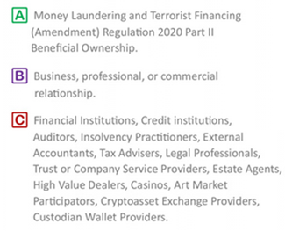
13
b). Polar bear structure
UK non-resident trust not registered with TRS unless acquires land (except co-ownership trust)^{A}, or liable for UK taxes on capital or income, or enters into relationship^{B} with UK relevant person^{C}
Not registered with HMRC unless liable for UK tax income, shares, property)
Trust not registered in Norway if Norwegian trustee, unless owns Norwegian property or account with Norway FI
13

Slide 14
14
c). Trust can be a Custodial Institution for AEoI
The term “Financial Institution” means a Custodial Institution, a Depository Institution, an Investment Entity, or a Specified Insurance Company.
HMRC IEIM400700 confirms that a trust can be a Custodial Institution. A trust can be either a financial institution or a Non-Financial Entity. Where a trust meets one of the definitions for being a Financial Institution it is most likely to be an Investment Entity, but it may, alternatively meet the requirements for being a Custodial Institution.
Whether an Entity is subject to financial laws and regulations of a Participating Jurisdiction or is subject to supervision and examination by agencies having regulatory oversight of Financial Institutions, is relevant to, but not necessarily determinative of, whether that Entity qualifies as a Financial Institution.

Slide 15
c). Trust can be a Custodial Institution for AEoI
15
A trust is a Custodial Institution for CRS/FATCA if:
It is an entity
Holds Financial Assets on behalf of others (for beneficiaries)
Earns at least 20% of its income from holding financial assets and providing related financial services
Custody fees CRS Section VIII.A4
The following types of income attributable to holding financial assets and providing related financial services:
Custody, account maintenance and transfer fees
Commissions and fees earned from executing and pricing securities transactions
Income earned from extending credit to customers
Income earned from contracts for differences and as the bid-ask spread of financial assets
Fees for providing financial advice with respect to Financial Assets held in (or potentially to be held in) custody by the entity
Fees for providing clearance and settlement services

Slide 16

d). Resettle/decant polar bear custodian to new trust/foundation
16
Settlor is a non-reportable FI
Do not look-through FI trust settlor
Report on beneficiaries but not on the FI Settlor
(see HK guidance)
Individual Trustee
Svalbard resident
Corporate Trustee/board
resident anywhere
Non-UK Trust
(Custodial Institution)
Any foundation/ trust
(Investment Entity)
Settlor
Beneficiaries

Slide 17
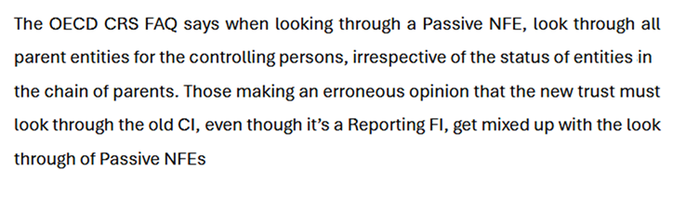
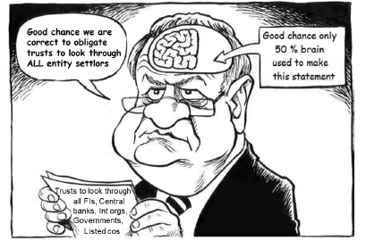
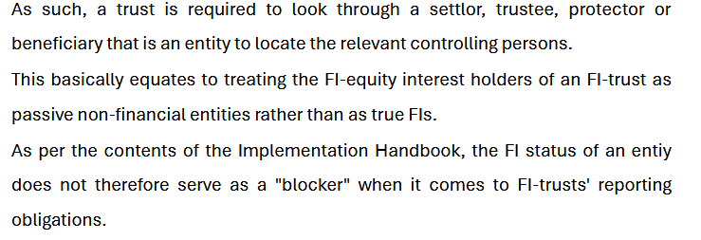
17
d). Resettle/decant polar bear custodian to new trust/foundation
Incorrect CRS guidelines for trusts to look through FI controlling persons

Slide 18
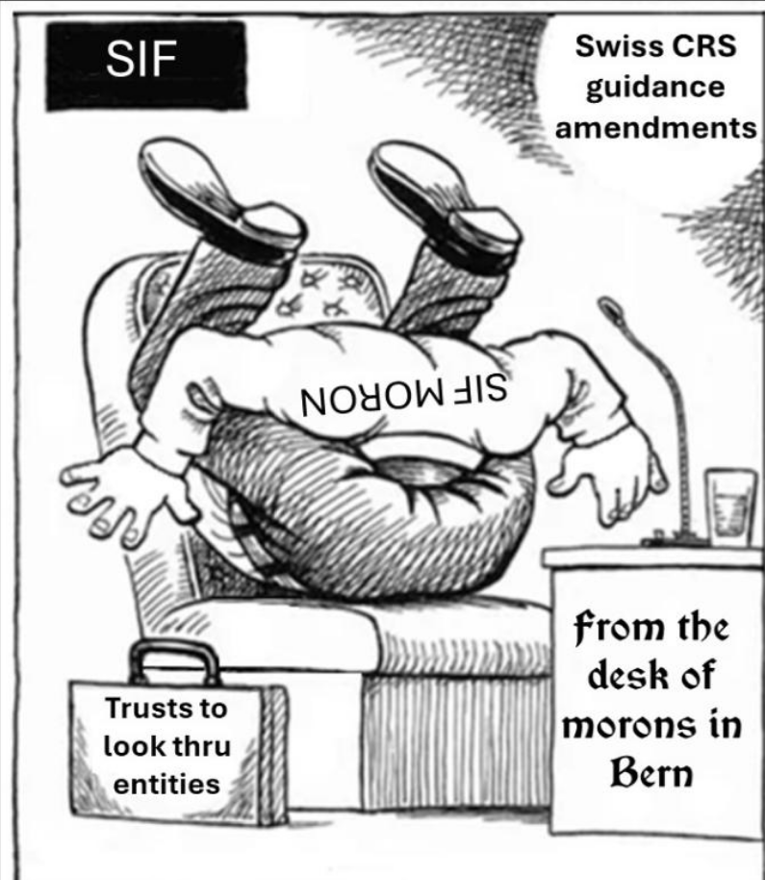
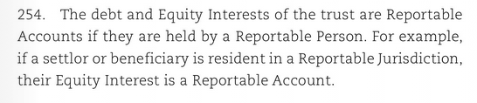
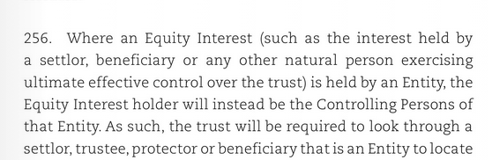
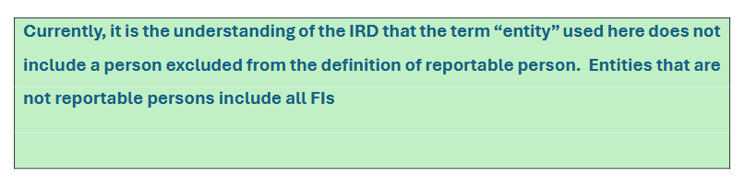
18
d). Resettle/decant polar bear custodian to new trust/foundation
Incorrect CRS guidelines for trusts to look through all entities including FI
CRS Implementation handbook pg. 109
Doesnt say this includes non-reportable entity
CRS Commentary pg. 178

Slide 19

19
d). Resettle polar bear custodian to any trust/foundation
Asset protection hoax of confidentiality, statute of limitations, burden of proof, fraudulent disposition, spendthrift, ignore force heirship….
Courts target settlors with contempt of court unless repatriate assets
Fake claim that individual cannot be jailed for failing to do something that is “impossible”.
However, courts have ruled that if the settlor intentionally created the “impossibility” by transferring assets into a trust they can no longer access, the “impossible defence” may not apply.
Particularly where the court believes the individual retains some measure of control or influence over the foreign trustee, e.g. via protector
A judge may issue a contempt order, potentially leading to the settlor's imprisonment until they "arrange" for the assets to be repatriated.
Assets cannot be proved to belong to a polar bear custodian settlor
Confidentality

Slide 20
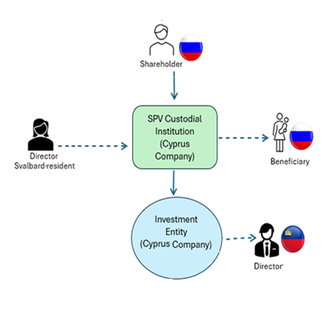
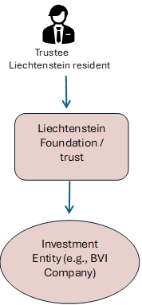
e). Structure to resolve Russian zombie trust crisis
20
MoF issued an announcement making clarifications on the 5th package of sanctions of the European Commission against Russia, specifically addressing the recent prohibition introduced under Article 5m of Regulation (EU) 833/2014 which prohibits the provision of certain trust services.
The prohibition refers to the registration, provision of registered office, business or administrative address, as well as management services to new trusts or similar legal arrangements, which trigger the application of Article 5m
Ministry of Finance Article 5m Guidance April 12, 2022- Cyprus sanction guidelines explicitly clarifies that the term «similar legal arrangements» does not extend to companies.
The guidance makes clear that while the sanctions target trusts and similar legal arrangements, companies are treated as separate entities and are not considered trusts for these purposes.
Fiduciary services is
split of legal and beneficial ownership, and
A fiduciary bond (active decisions managing assets for beneficiaries)
A custodian is a gatekeeper, vault, primarily about safety and accurate record-keeping.
The client retains all decision-making power. The custodian is a passive, service-oriented entity.

Slide 21
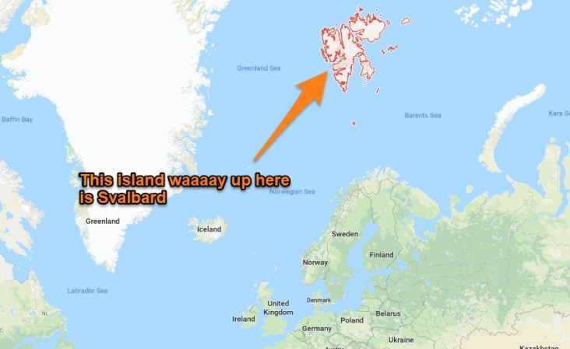
21
f). Territories & dependencies excluded from Norway’s tax agreements
78⁰ N, 1,300 km to N. Pole
Terra nullius (nobody′s land) until 1925 Treaty of Svalbard
Recognised Norway′s sovereignty
Ratified by 48 countries
71⁰ N
Jan Mayen
Bear Island
Svalbard (“cold shores”) is an archipelago in the Arctic Ocean, integral part of the Kingdom of Norway, but not all Norwegian laws apply.
Despite SJ being unincorporated areas not governed by own local government, neither is considered a dependency of Norway.

Slide 22
22
f). Territories & dependencies excluded from Norway’s tax agreements
Svalbard is integral part of Norway
Norwegian civil, criminal law procedural law apply to Svalbard unless other provisions are made in the 1925 Svalbard treaty
Article 8 Svalbard treaty states tax must only used for Svalbard and tax be non-discriminatory for signatories. Hence no signatory can get benefits from a tax treaty nor obtain some of its taxes
Tax treaties co-ordinate tax policies would result in signatories having a beneficial tax rate which would violate Article 8.
Norway’s international agreements thus exclude Svalbard from :
  Tax Treaties and Tax Information Exchange Agreements
  Bilateral Agreements
  OECD MCAA (legal basis for AEoI, and EoR)
  FATCA IGAs
For the purposes of this Agreement, unless otherwise defined the term "Norway" means the Kingdom of Norway, and includes the land territory and internal waters, the territorial sea and the area beyond the territorial sea where the Kingdom of Norway, according to Norwegian legislation and in accordance with international law, may exercise her rights with respect to the seabed and subsoil and their natural resources; the term does not comprise Svalbard, Jan Mayen and the Norwegian dependencies (“biland”).

Slide 23
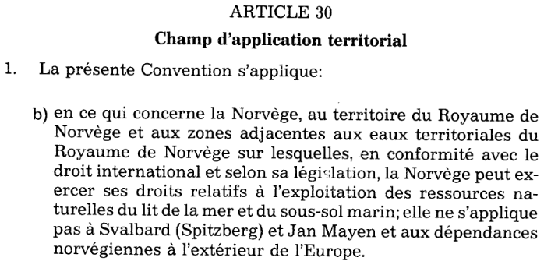
23
f). Territories & dependencies excluded from Norway’s tax agreements
Austria
Germany
France
CONVENTION BETWEEN THE KINGDOM OF NORWAY AND THE REPUBLIC OF AUSTRIA FOR THE AVOIDANCE OF DOUBLE TAXATION AND THE PREVENTION OF FISCAL EVASION WITH RESPECT TO TAXES ON INCOME AND ON CAPITAL
1995
ABKOMMEN ZWISCHEN DEM KÖNIGREICH NORWEGEN UND DER BUNDESREPUBLIK DEUTSCHLAND ZUR VERMEIDUNG DER DOPPELBESTEUERUNG UND ÜBER GEGENSEITIGE AMTSHILFE AUF DEM GEBIET DER STEUERN VOM EINKOMMEN UND VOM VERMÖGEN
2007
AVENANT
A LA CONVENTION ENTRE LE GOUVERNEMENT DU
ROYAUME DE NORVÈGE ET LE GOUVERNEMENT DE LA RÉPUBLIQUE
FRANÇAISE EN VUE D'ÉVITER LES DOUBLES IMPOSITIONS, DE PRÉVENIR
L'ÉVASION FISCALE ET D'ÉTABLIR DES RÈGLES D'ASSISTANCE ADMINISTRATIVE
RÉCIPROQUE EN MATIÈRE D'IMPÔTS SUR LE REVENU ET SUR LA FORTUNE
(ENSEMBLE UN PROTOCOLE ET UN PROTOCOLE ADDITIONNEL), MODIFIÉE PAR
L'AVENANT DU 14 NOVEMBRE
1984
Albania | Argentina | Azerbaijan
Australia | Austria | Bangladesh
Barbados | Belgium | Benin
Bosnia Hercegovina | Brazil | Bulgaria
Cayman | Canada | Chile
China | Croatia | Cyprus
Czech republic | Denmark | Egypt
Estonia | Faroe Islands | Finland
France | Gambia | Georgia
Germany | Greece | Greenland
Hungary | Iceland | India
Indonesia | Iran | Ireland
Israel | Italy | Ivory Coast
Jamaica | Japan | Kazakhstan
Kenyav | Latvia | Lithuania
Luxembourg | Macedonia | Malawi
Malaysia | Malta | Morocco
Mexico | Nepal | Netherlands
Neth. Antilles | New Zealand | Pakistan
Philippines | Poland | Portugal
Qatar | Romania | Russia
Senegal | Serbia | Sierra Leone
Serbia Singapore | Slovakia | Slovenia
South Africa | South Korea North Korea | Spain
Sri Lanka | Sweden | Switzerland
Tanzania | Thailand | Trinidad and Tobago
Tunisia | Turkey | Uganda
Ukraine | UK | USA
Venezuela | Vietnam | Zambia
Zimbabwe
…the term "Norway" means the Kingdom of Norway, including any area outside the territorial waters of the Kingdom of Norway where the Kingdom of Norway, according to Norwegian legislation and in accordance with international law, may exercise her rights with respect to the seabed and subsoil and their natural resources; the term does not comprise Svalbard, Jan Mayen and the Norwegian dependencies ("biland");
…bedeutet der Ausdruck "Königreich Norwegen" das Königreich Norwegen einschließlich aller Gebiete außerhalb der Hoheitsgewässer des Königreichs Norwegen, in denen das Königreich Norwegen nach norwegischem Recht und in šbereinstimmung mit dem Völkerrecht seine Rechte hinsichtlich des Meeresbodens und Meeresuntergrunds sowie ihrer Naturschätze ausüben darf; der Ausdruck umfaßt nicht Svalbard, Jan Mayen und die abhängigen Gebiete Norwegens ("biland");

Slide 24
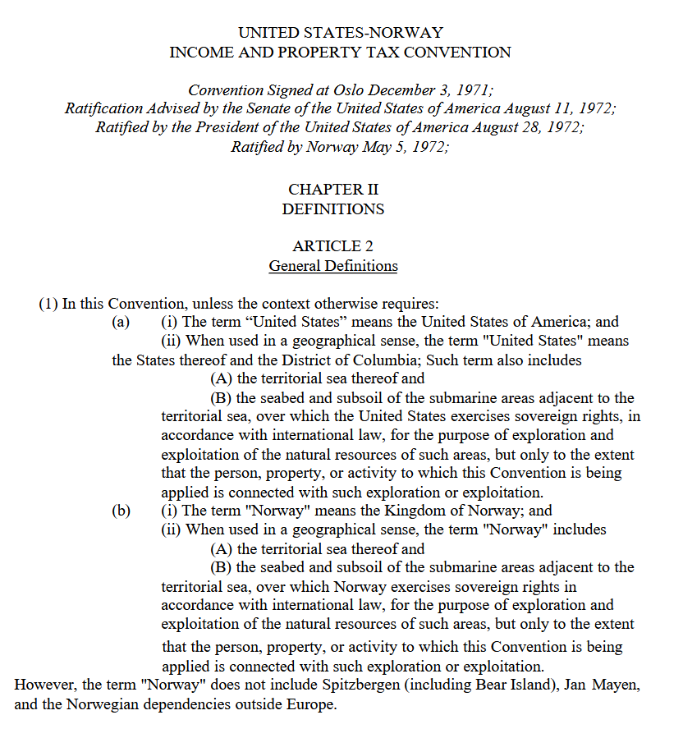
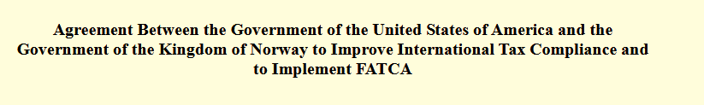
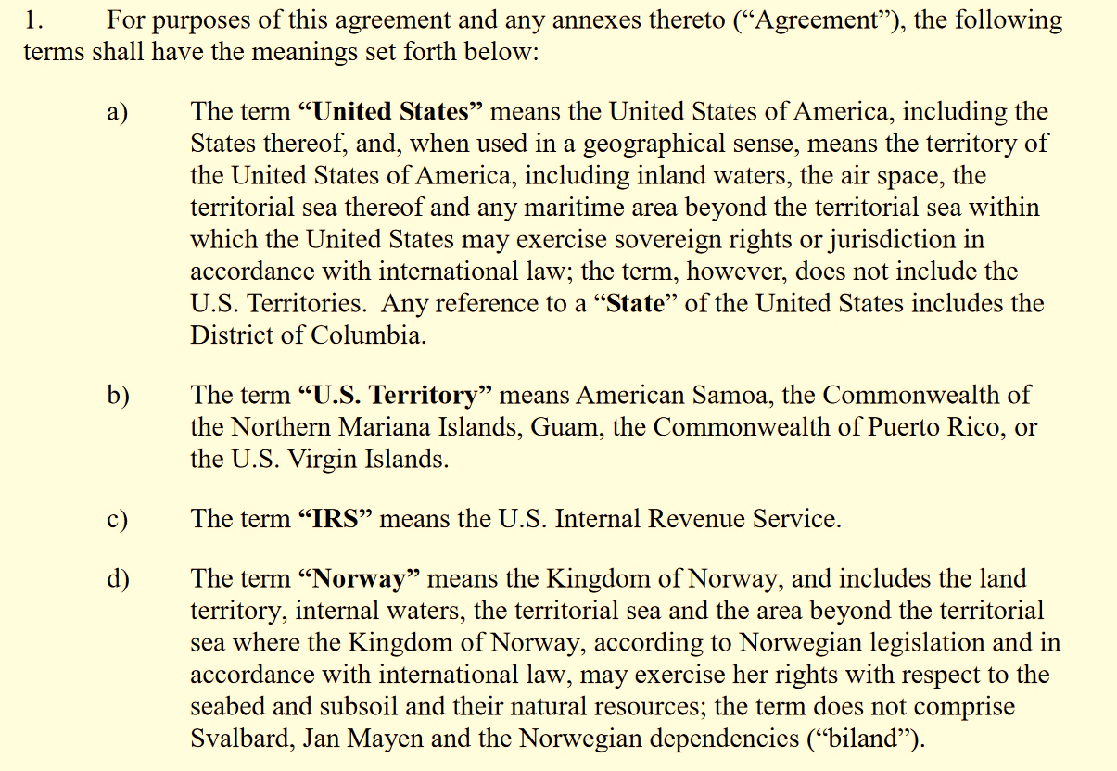
24
f). Territories & dependencies excluded from Norway’s tax agreements
No FATCA, nor 30% withholding

Slide 25

25
f). Territories & dependencies excluded from Norway’s tax agreements
No FATCA, nor 30% withholding
EAG are FIs with common ownership of 50%
If one member is a non-particpating FFI, then all are considered a non-particpating FFI
If the CI trust is not a participating FFI, then 30% withholding on any payments to any member of the EAG (viz to the subsidiary Investment Entity)
However, under the general rule, only a corporation can be treated as the common parent of an EAG.
This means that a trust, which is not a corporation, would not automatically be included in an EAG.
However, the regulations provide an election that changes this treatment.
One rotten apple spoils the barrel
Impact of an election for Non-Corporate Entities:
The IRS regulations state that "an entity other than a corporation may elect to be treated as the common parent entity" for determining the composition of an EAG.
This indicates that including the CI trust in an EAG is not automatic but is optional through a formal election.
If the election is made, the trust would be treated as part of the EAG.
If the election is not made, the trust would likely not be considered a member of the EAG under the general rule

Slide 26
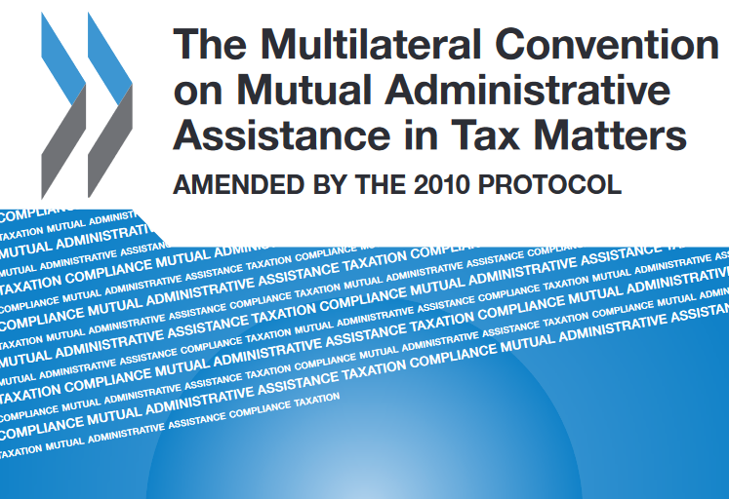
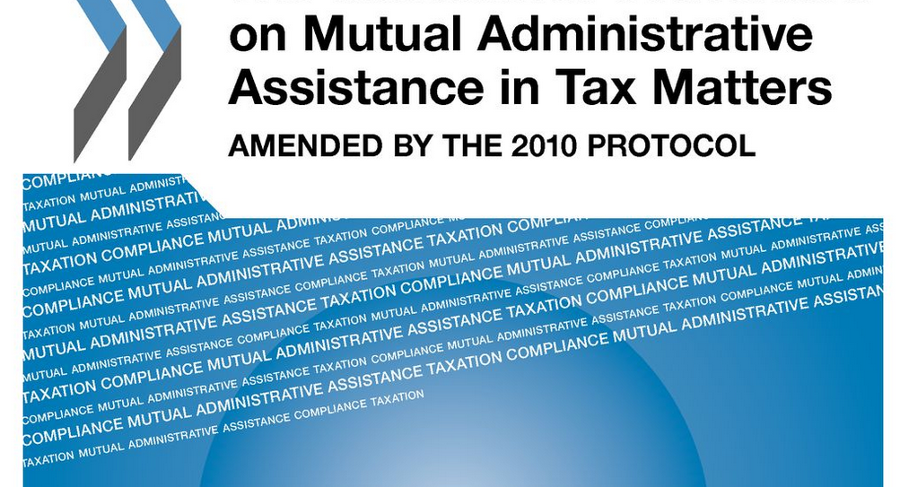


26
f). Territories and dependencies excluded from Norway’s tax agreements
Search Svalbard Pg 59
https://www.oecd.org/content/dam/oecd/en/publications/reports/2008/02/the-convention-on-mutual-administrative-assistance-in-tax-matters_g1gh88ba/9789264041042-en.pdf
Svalbard is the only territory in the world explicitly excluded from the OECD Multilateral Convention on Mutual Assistance in Tax Matters
Article 29 – Territorial application of the Convention
Each State may, at the time of signature, or when depositing its instrument of ratification, acceptance or approval, specify the territory or territories to which this Convention shall apply.
Any state may, at any later date, by a declaration addressed to one of the Depositaries, extend the application of this Convention to any other territory specified in the declaration. In respect of such territory the Convention shall enter into force on the first day of the month following the expiration of a period of three months after the date of receipt of such declaration by the Depositary.
NORWAY
Declaration contained in the instrument of ratification deposited on 13 June 1989 - Or. Engl.
As regards Norway the Convention on Mutual Administrative Assistance in Tax Matters shall apply to the territory of the Kingdom of Norway, including any area outside the territorial waters of the Kingdom of Norway, where the Kingdom of Norway, according to Norwegian legislation and in accordance with international law, may exercise her rights with respect to the seabed and subsoil and their natural resources; the Convention does not apply to Svalbard, Jan Mayen or the Norwegian dependencies ("biland").

Slide 27
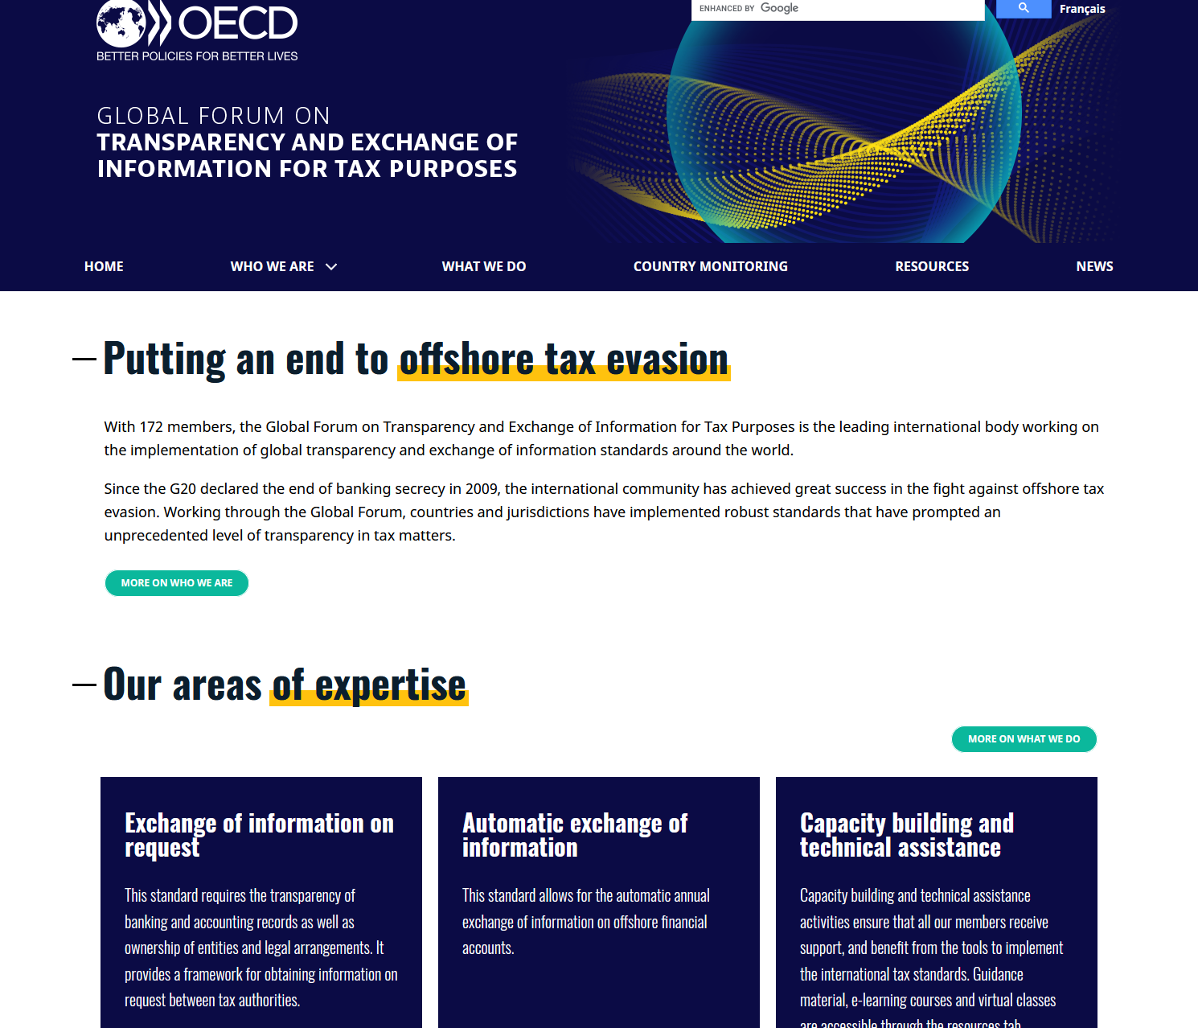

27
f). Territories and dependencies excluded from Norway’s tax agreements
Global Forum on Transparency and Exchange of Information for Tax Purposes Global Forum prioritises Exchange on Request
If any country issues exchange on Request to Norway about tax-residents with an Financial Institution in Svalbard…

Slide 28

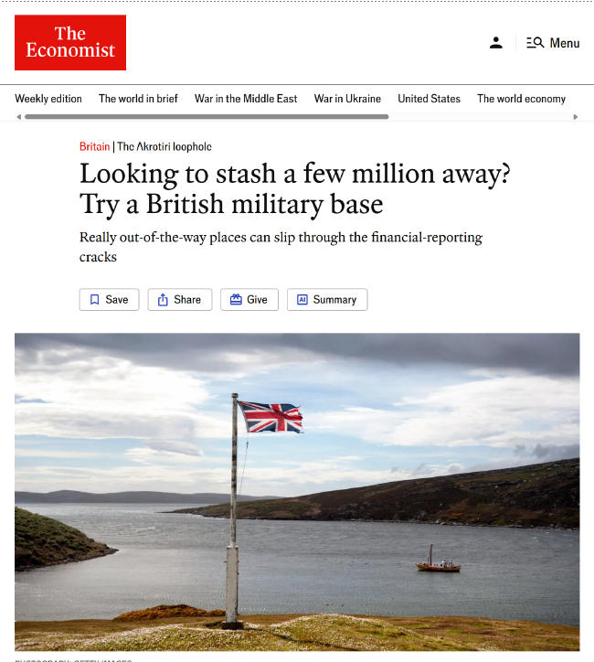
g). Alternate non-participating jurisdictions
28
Napoleon structure (St Helena)
Penguin structure (Falklands)
Military structure (Akrotiri )
Corporate trustee
Director Svalbard
Corporate trustee
Director Svalbard
Trustee UK national spouse of Crown Servant

Slide 29
29
h). LI/CH rejects EU/OECD Mandatory Disclosure Rules
DAC6 is not binding for Switzerland/Liechtenstein
No planned voluntary adoption of DAC6
To detect cross-border, potentially aggressive tax arrangements, the European Union has introduced a new tax transparency directive 2018/822 (DAC6)
DAC6 imposes mandatory disclosure requirements for certain arrangements with an EU cross-border element where the arrangements fall within certain 'hallmarks' mentioned in the directive and in certain instances where the main or expected benefit of the arrangement is tax advantage.(CRS avoidance)
Liechtenstein is a member of the European Economic Area but not of the European Union.
As the European Economic Area does not include the common tax policy, DAC6 is, as such, not binding for Liechtenstein.
There is currently no voluntary adaption of the DAC6 regulation planned in Liechtenstein. Hence, the DAC6 mandatory disclosure rule is not applicable for Liechtenstein intermediaries and companies.

